Slide 1
Issue Tracker

Slide 2
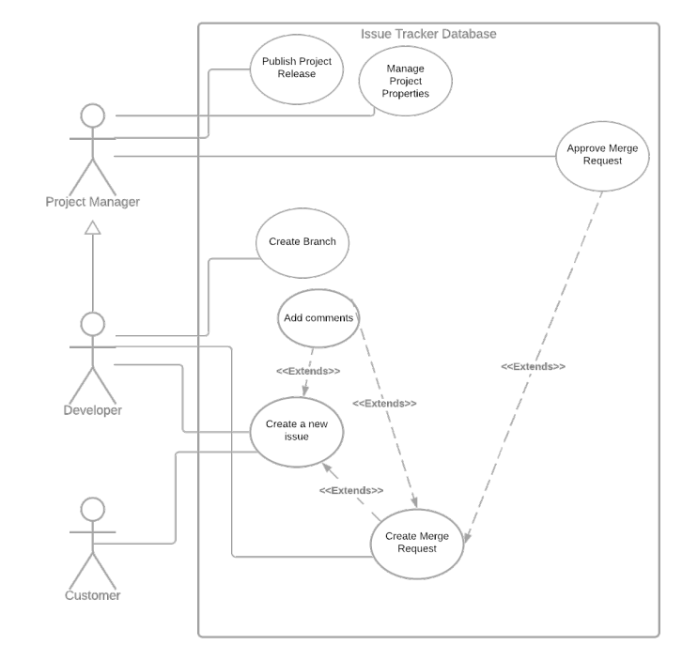
UML USE CASE

Slide 3
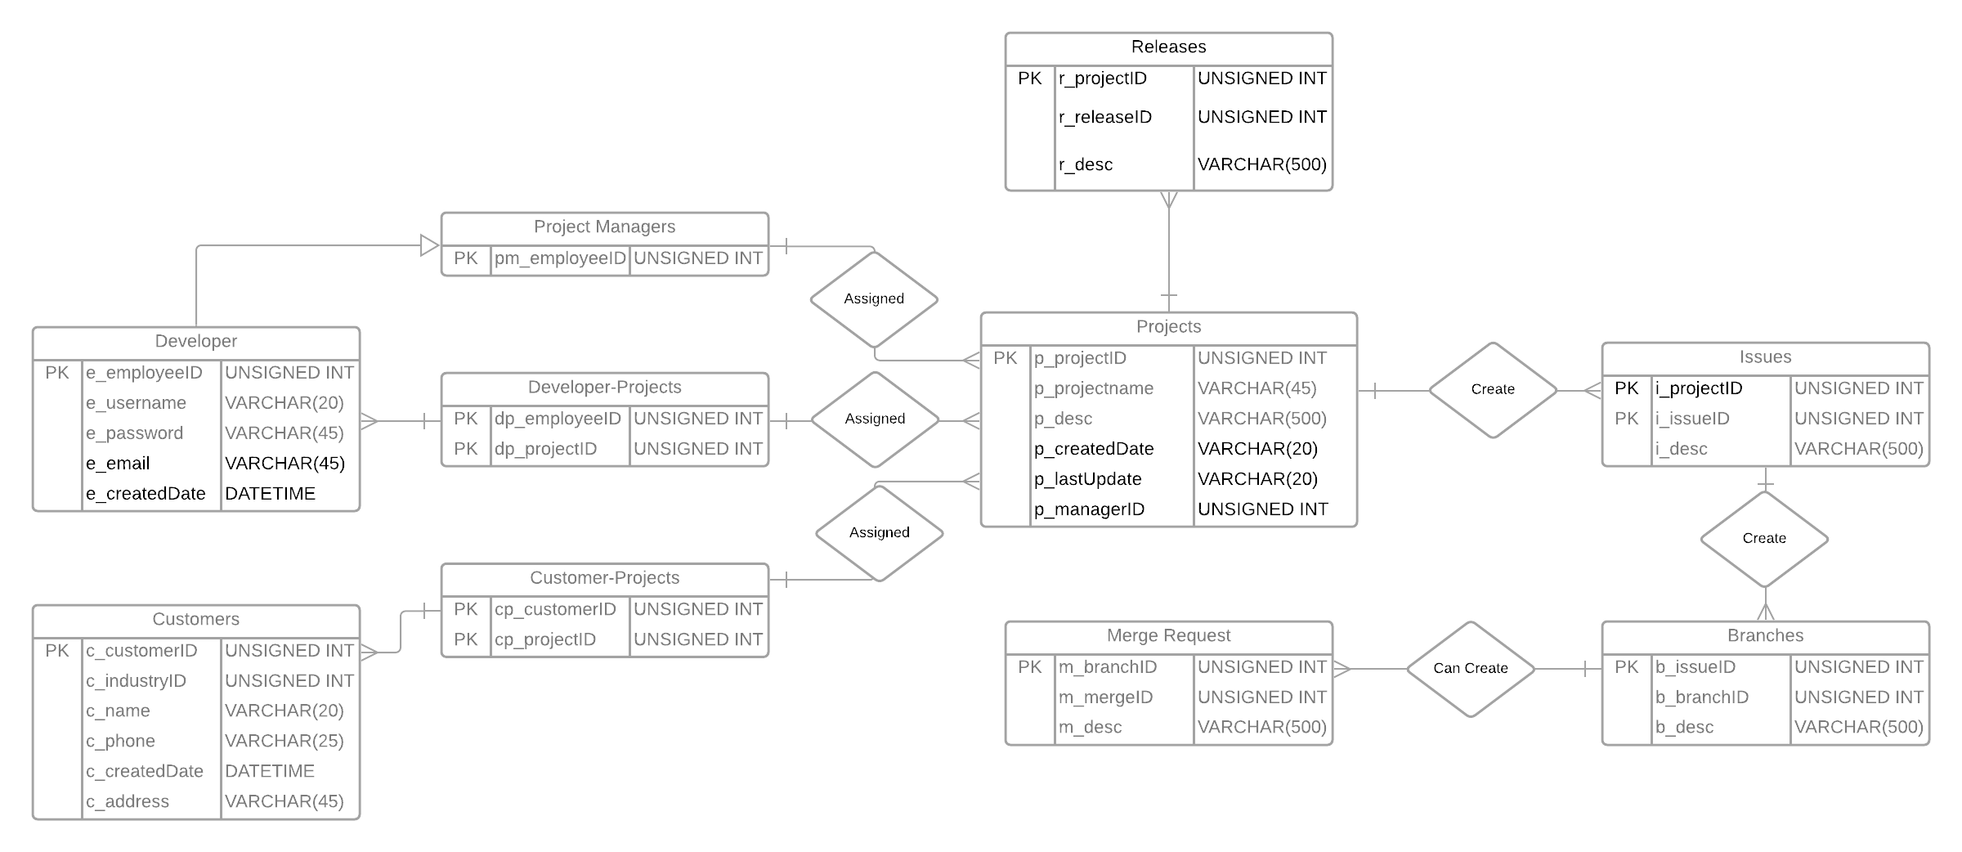
E/R Diagram w/ Schema

